Slide 1
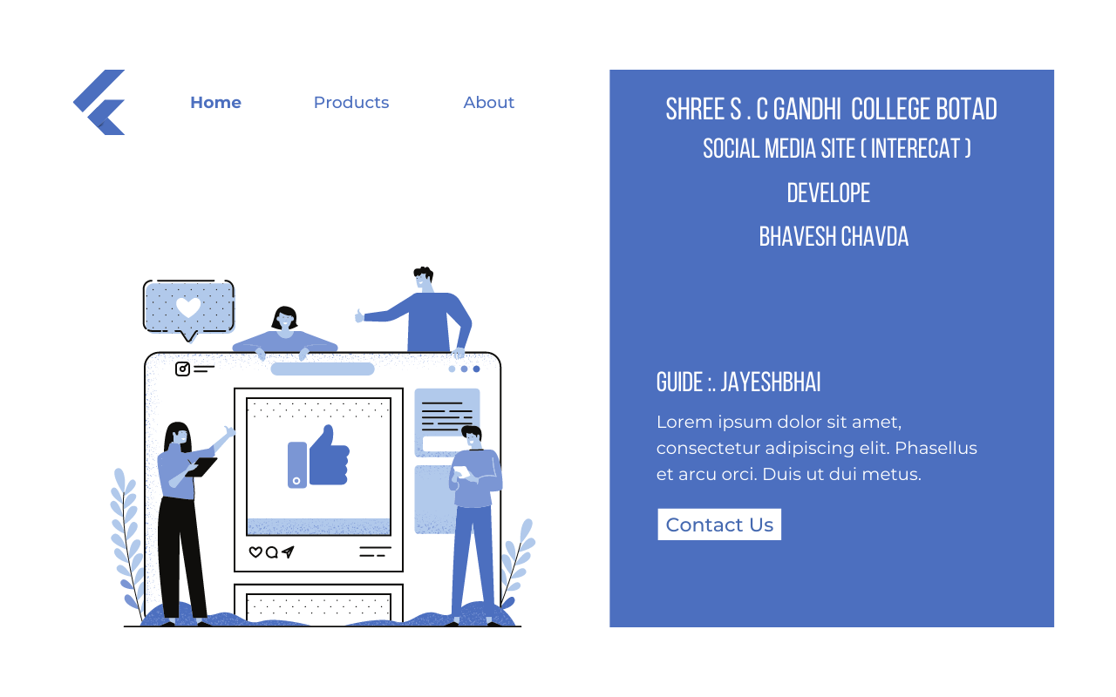




Seat no : 25260501
GUIED: JAYESH SIR BHUMIKA MEDAM

Slide 2

What is social network?
Social media is site using we make friends different country also over country social media through interact over internet . It is platform that also share over day to day happy hour within picture video in now day social media is platform to earning money also and it also use in business to grow using digital marketing .

Slide 3

Inspiration

Slide 4
-> My motivation of making this project is MARK JUKERBERG who founder or cofounder of FACBOOK social media site.
-> When I joined my first day of college that time I thought I will create my best application .
-> and first photo came over my face who person is MARK JUKERBERG and bill gates.
I inspire this person and his simplicity . mark is vary simple look and behavior
He leave simple 2 BHK flat . and his have only 7 T-shirt how good person he.!
-> His thought “simple living high thinking”.
-> He doesn’t made his life complicate to waste on thing. I like her thought .
-> I can’t made social media site like his .but I try my best and create less similar site.
-> I also thank my favorite app you-tube which always help to make my site I think it is best app create in all over word and provide education.
-> Some logic and design make using you-tube. I also thank you-tuber who provide deep learning in programming language.
-> I want good programmer And make use full software and site.
-> am not good at theory but good at programming .
-> When I start my project I did not think I made this project but it done
Many obstacle came when I develop this site but I never stop keep leaning and make this project.

Slide 5
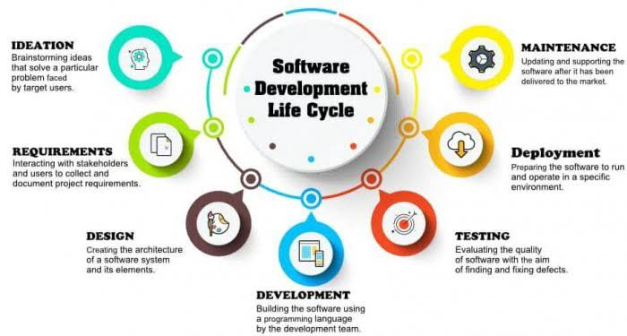

Slide 6

Identified problem analysis

Slide 7
Online source :
Youtube Facbook
> code with harry instagram
> code ninja twiter
> bahadur thapa Fontawsome
google
codepen
Analysis :
Which topic make project?
Main thing in analysis you have authenticate sources
Which language you need to make the project
Analysis other social media site design , feature
Time duration of the project done
Designing and codding both work same time
Analysis complexity of feature code
Which advance language you need
Define any prototype system requirements
Evaluate alternatives to existing prototypes
Perform research and analysis to determine the needs of the end-users
Furthermore developers will often create a software requirement specification or SRS document . this includes all the specifications for software , hardware , and network requirement for the system they plan to build . this will prevent them from overdrawing funding or resources when working at the same place as other development teams.

Slide 8

Development Step

Slide 9
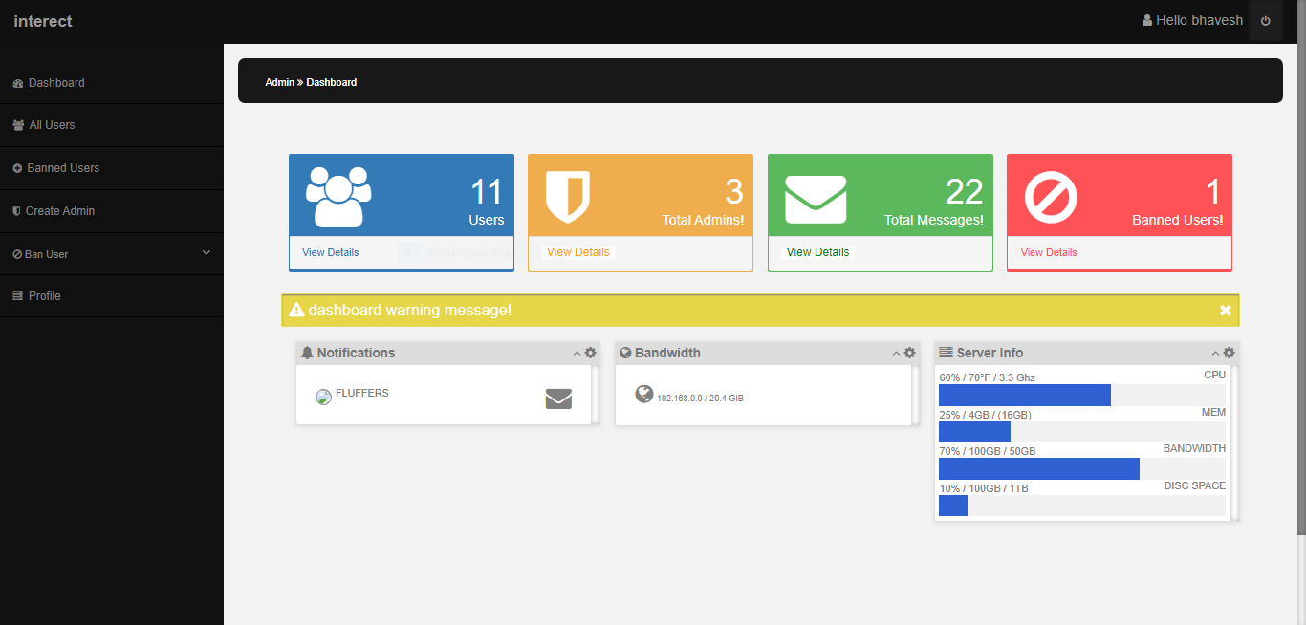
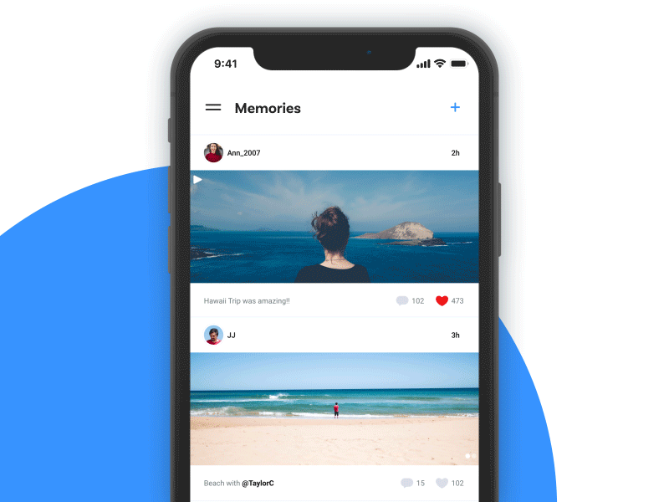
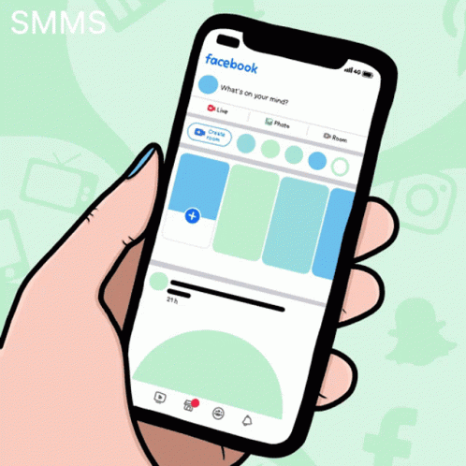
Social media web
Site
user
admin
Admin panel
Site
User

Slide 10
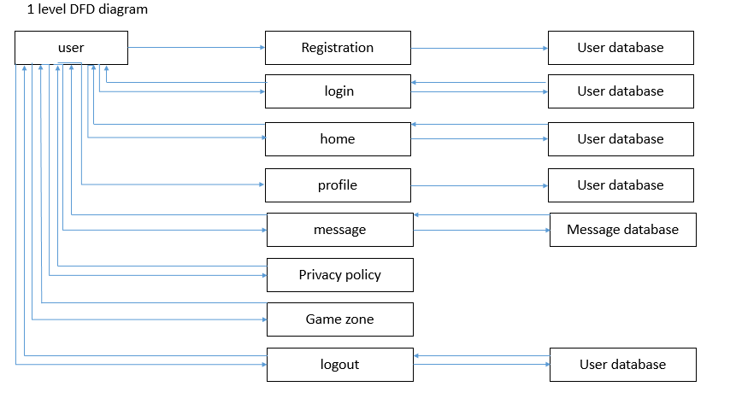

Slide 11
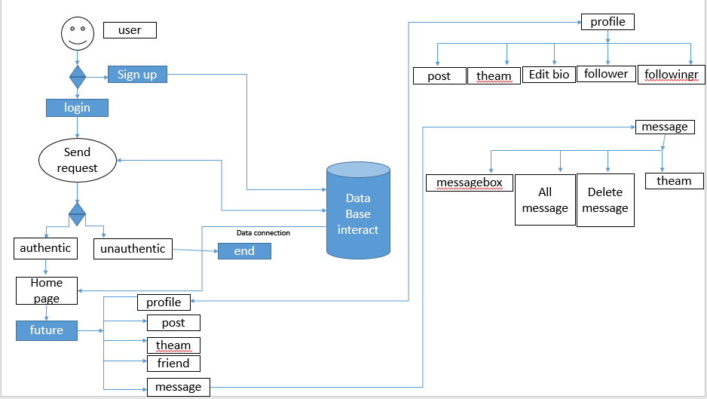

Slide 12
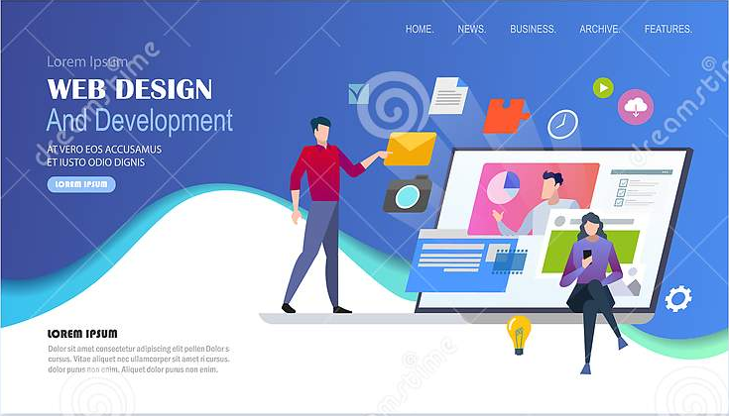

Slide 13
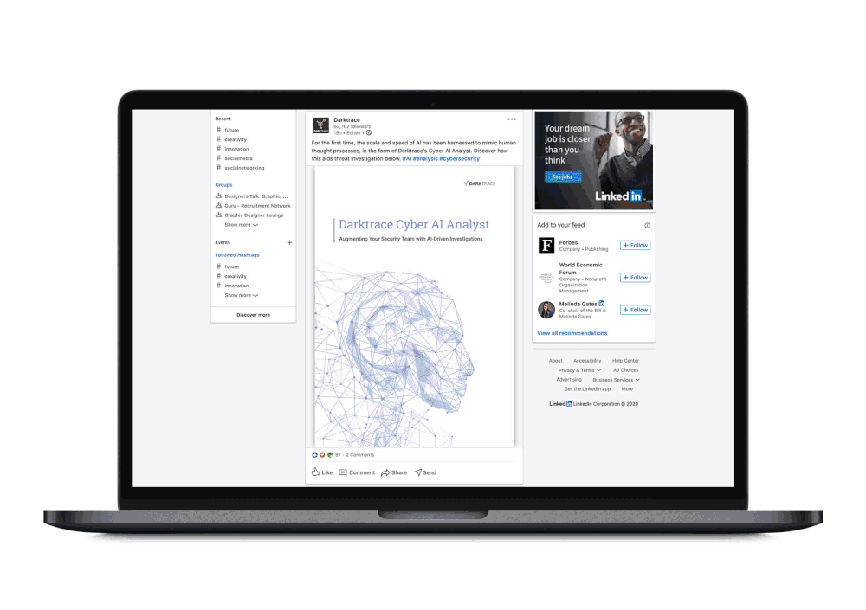
HTML
PHP
JAVA SCRIPT
CSS

Slide 14


Slide 15

Testing

Slide 16
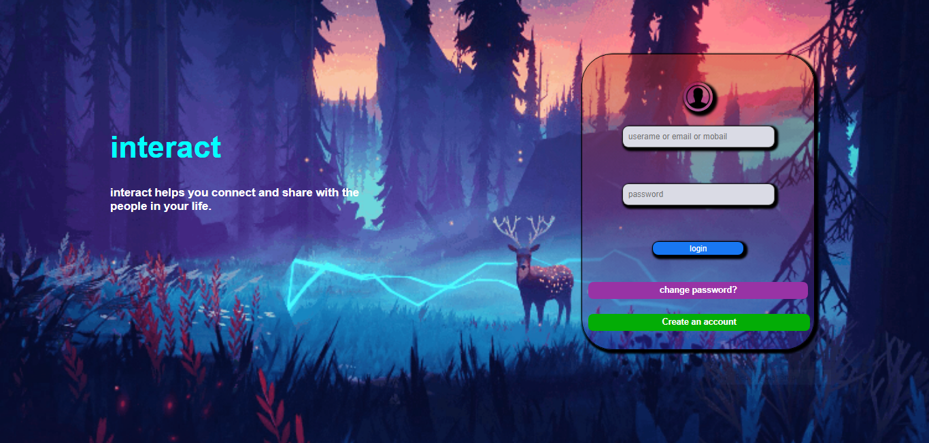


Slide 17


Slide 18
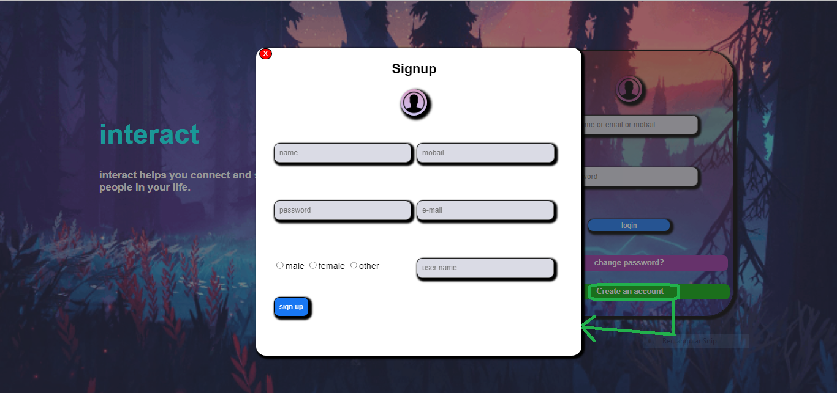

Slide 19
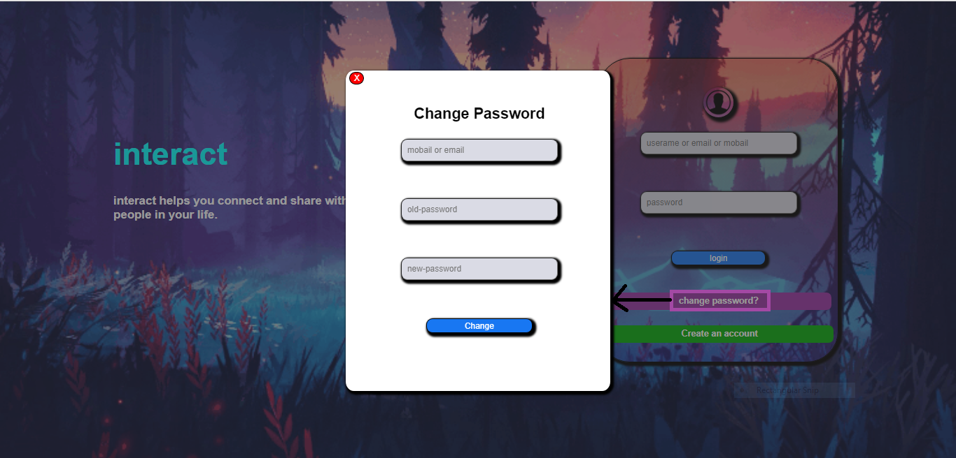

Slide 20
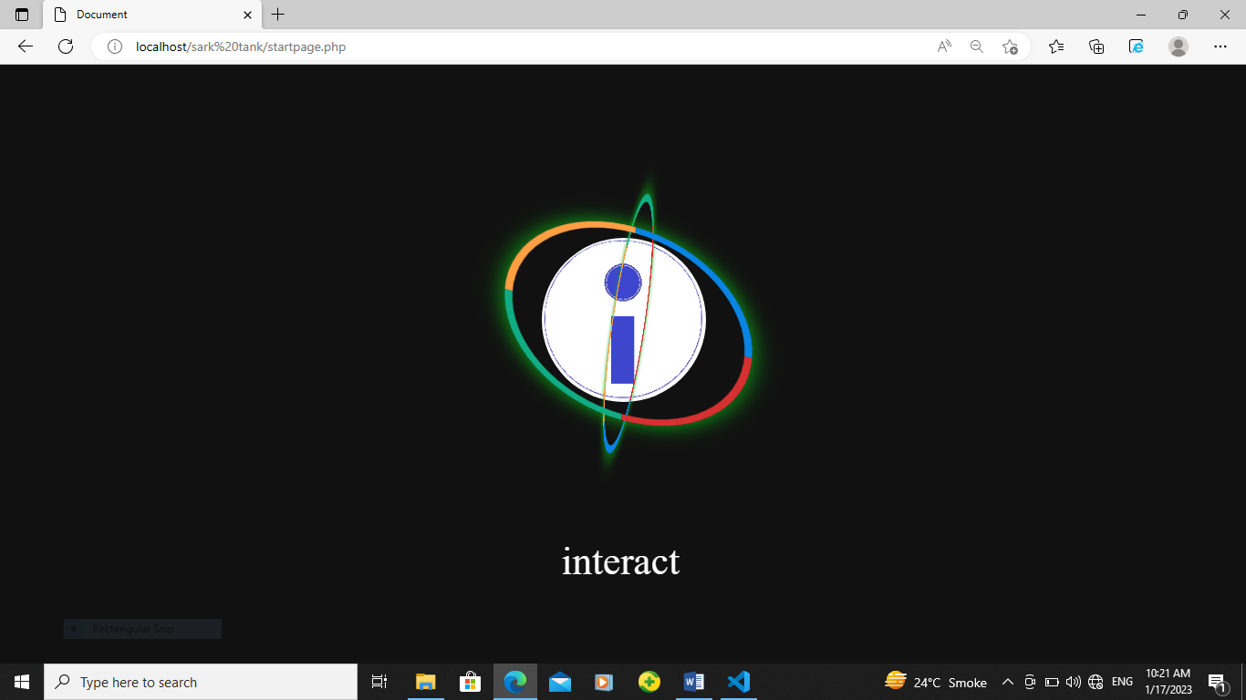

i

Slide 21
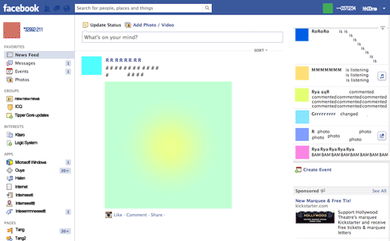
interact

Slide 22
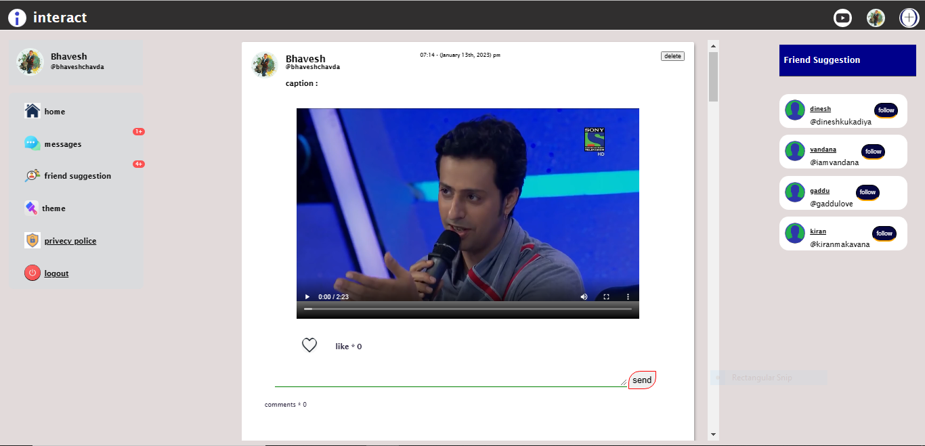

Slide 23
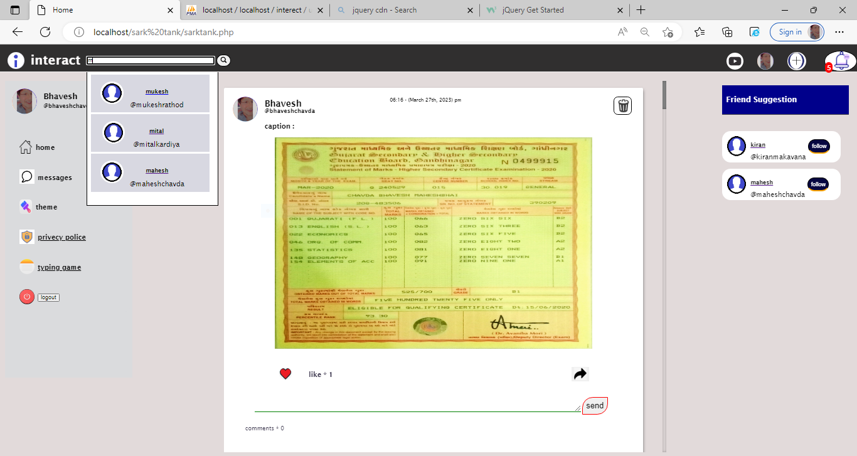


Slide 24
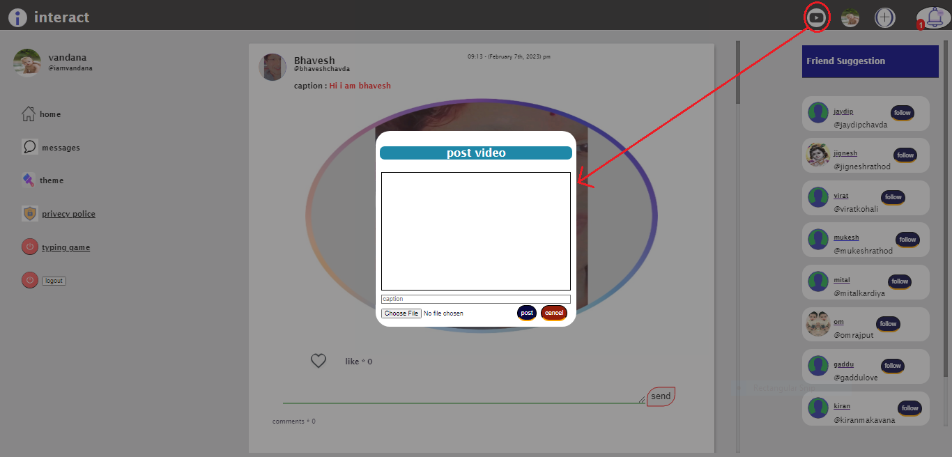

Slide 25
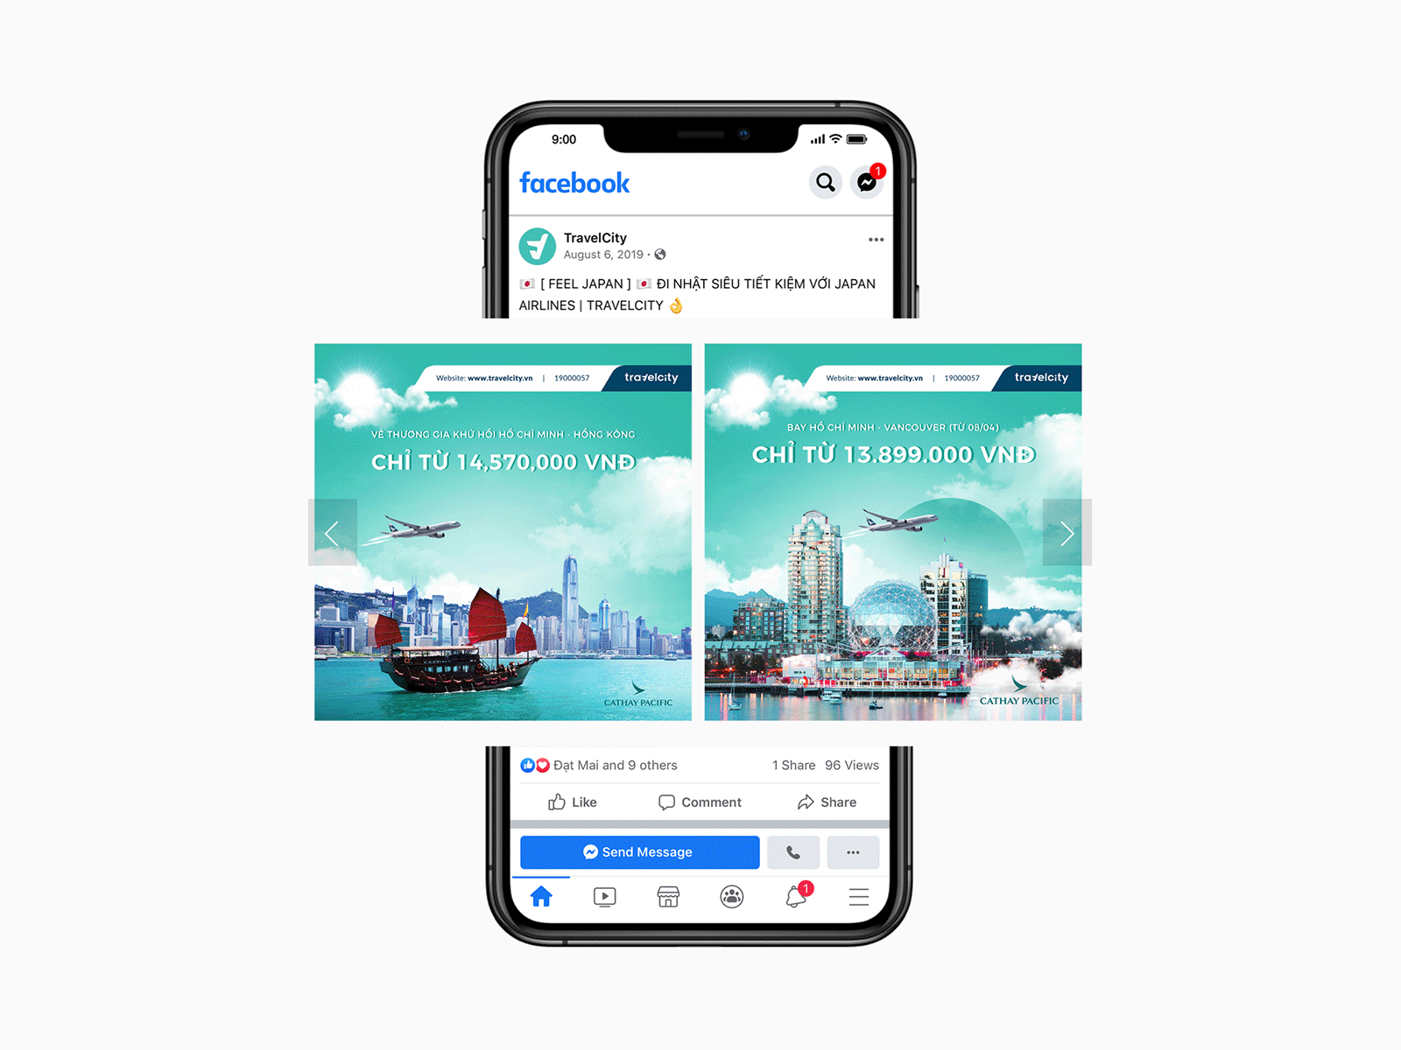
Explore word and share your picture
interact

Slide 26
If(isset($_POST[‘post’])){
post();}
Function post(){
Connection();
Query=“insert post”;
Run(query)}

Slide 27
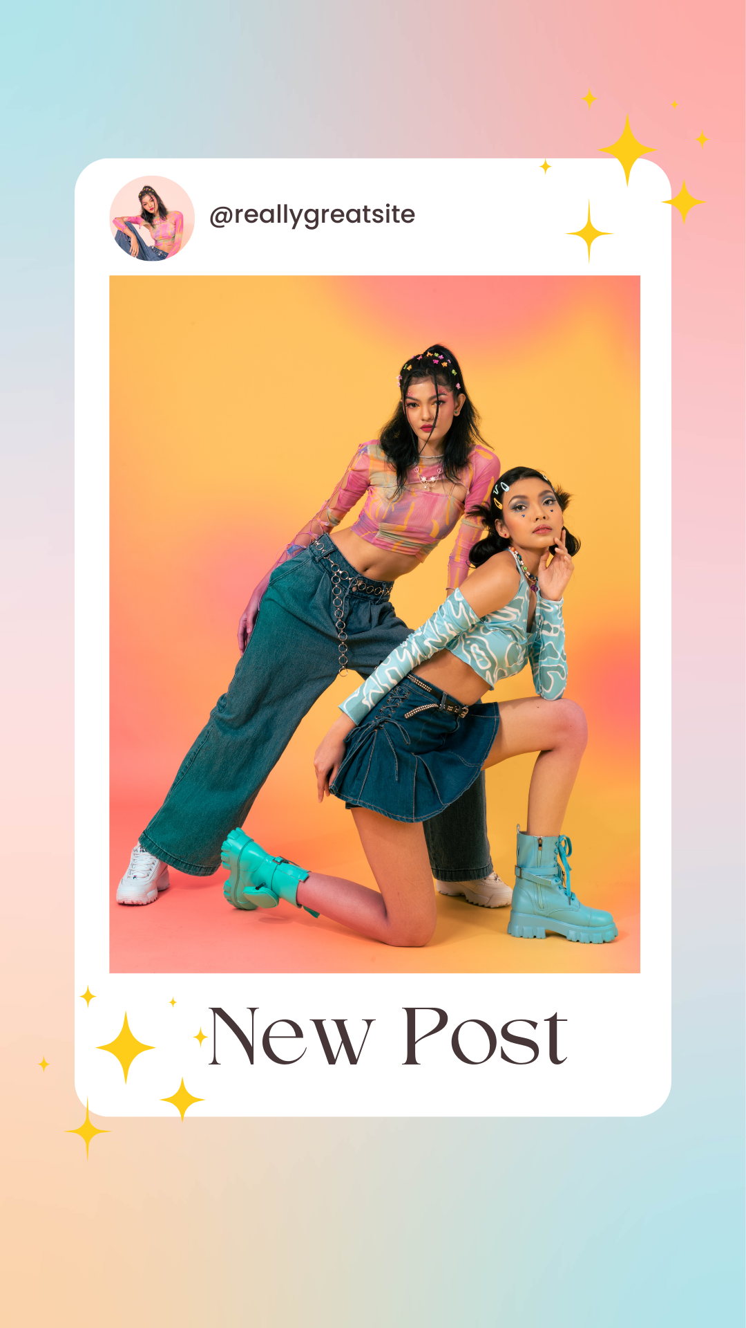
Interact is site that help to to share your experience and send post to other people explore site and visited take photo and share on the site
You can also share your thought on site
Like some one and made day of your relative
Your friends

Slide 28
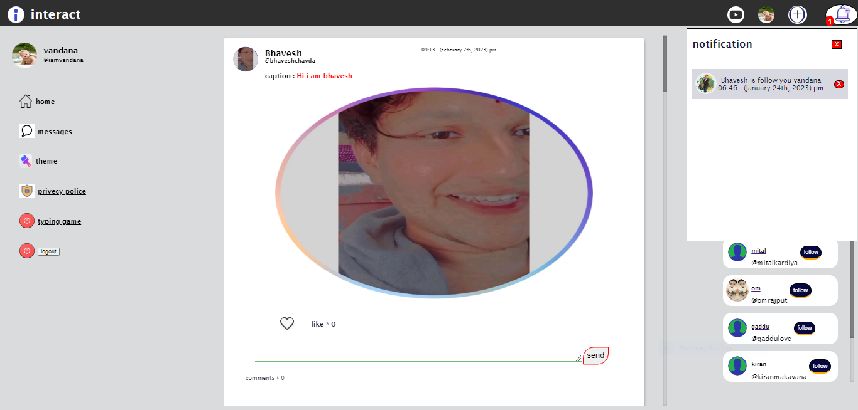


Slide 29
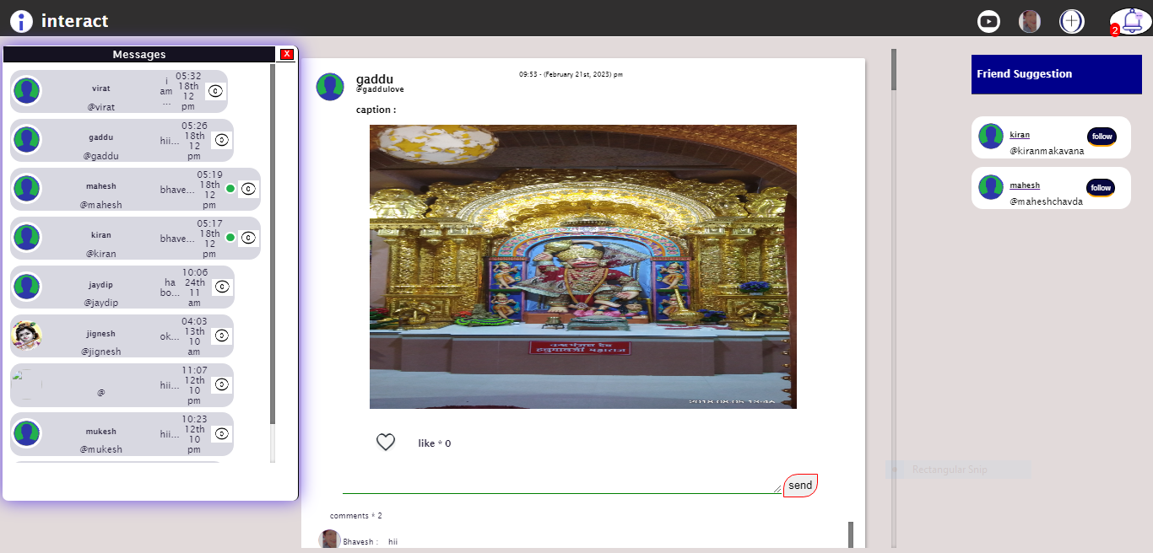

Slide 30
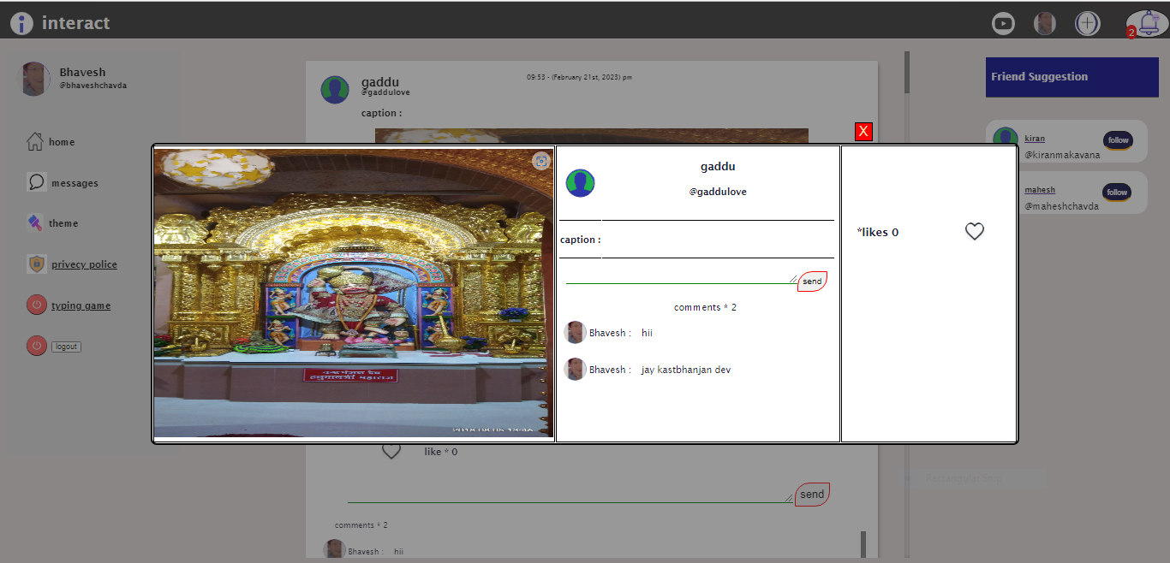

Slide 31
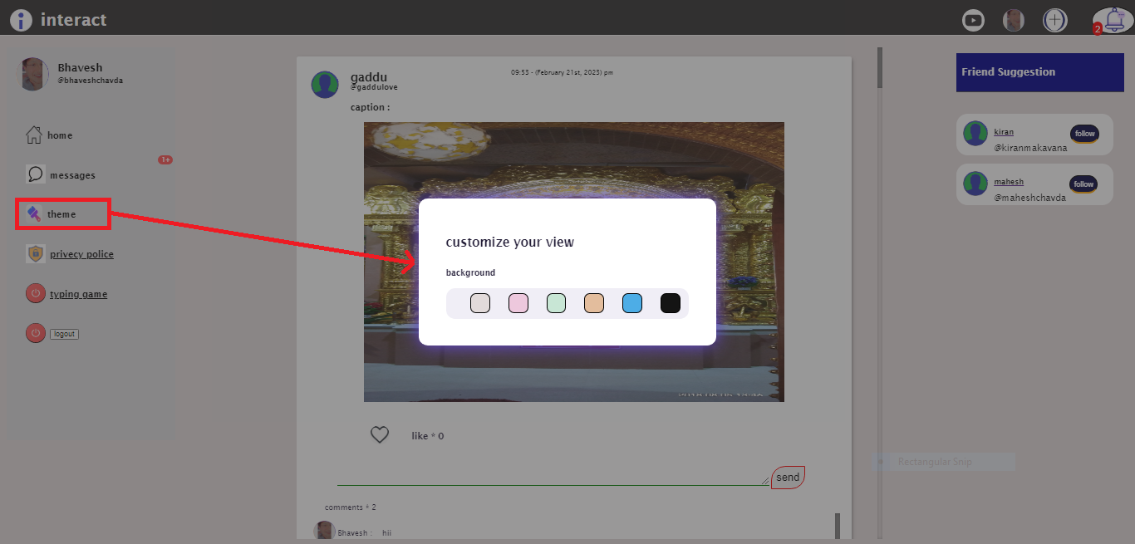

Slide 32
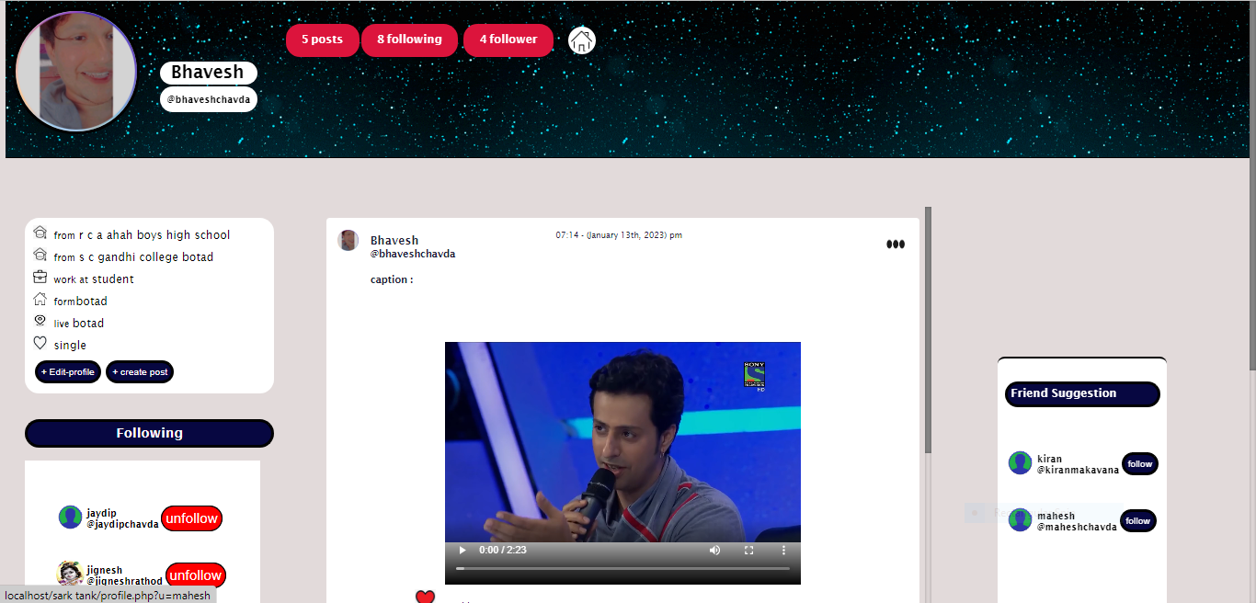

Slide 33
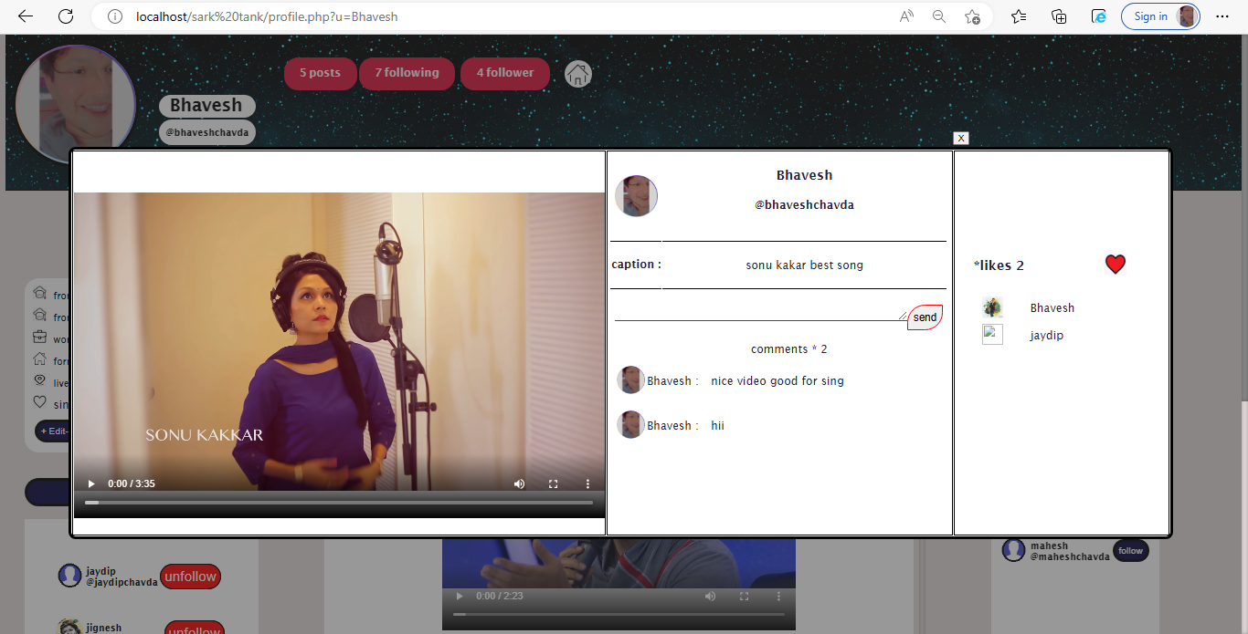

Slide 34
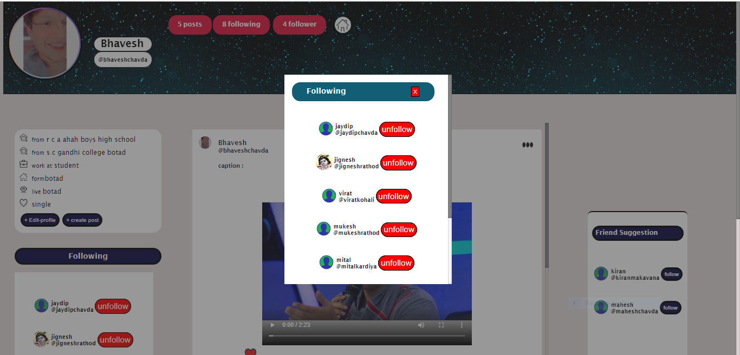

Slide 35
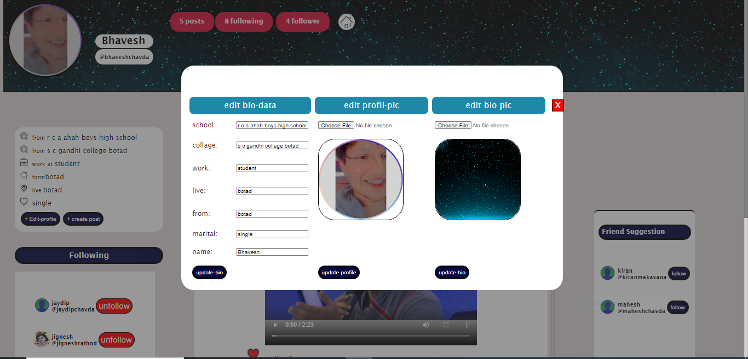


Slide 36
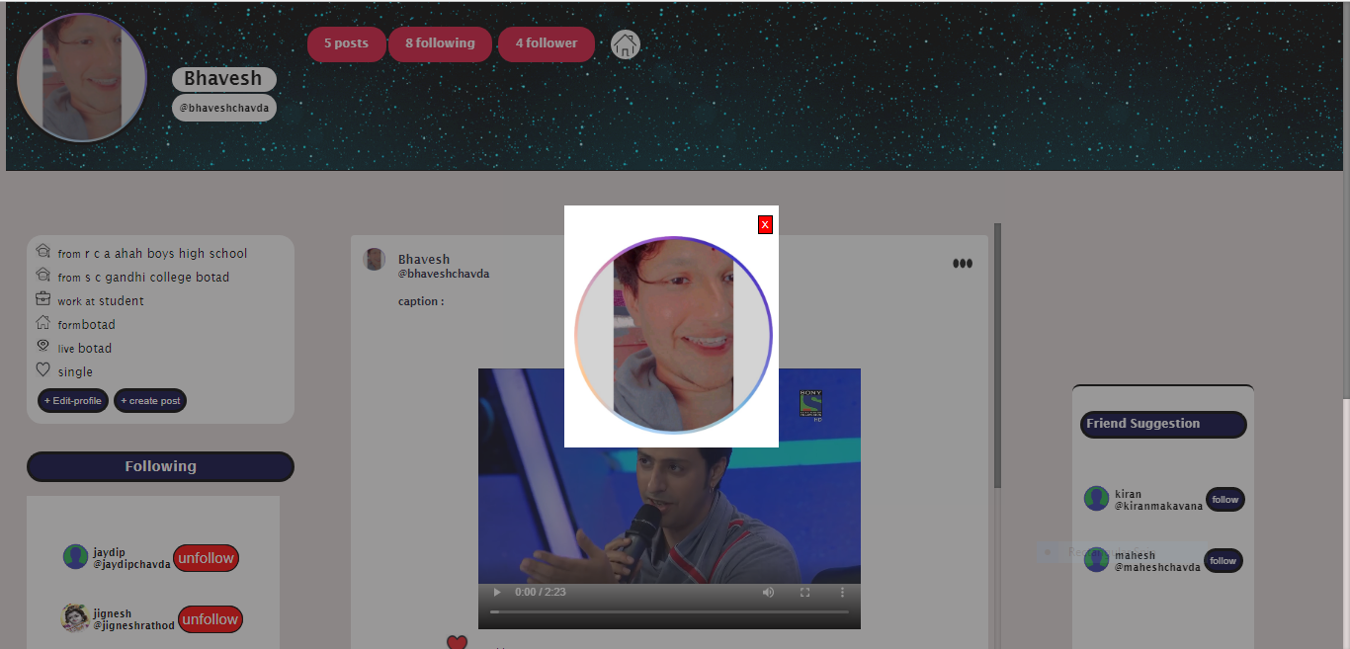

Slide 37

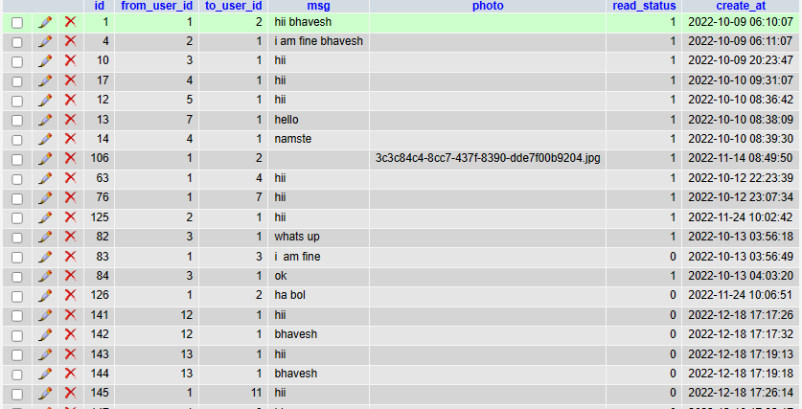
If(isset($_POST[‘send’])){
Messagessend();}
Function messagessend(){
Connection();
Query=“insert message”;
Run(query)}

Slide 38
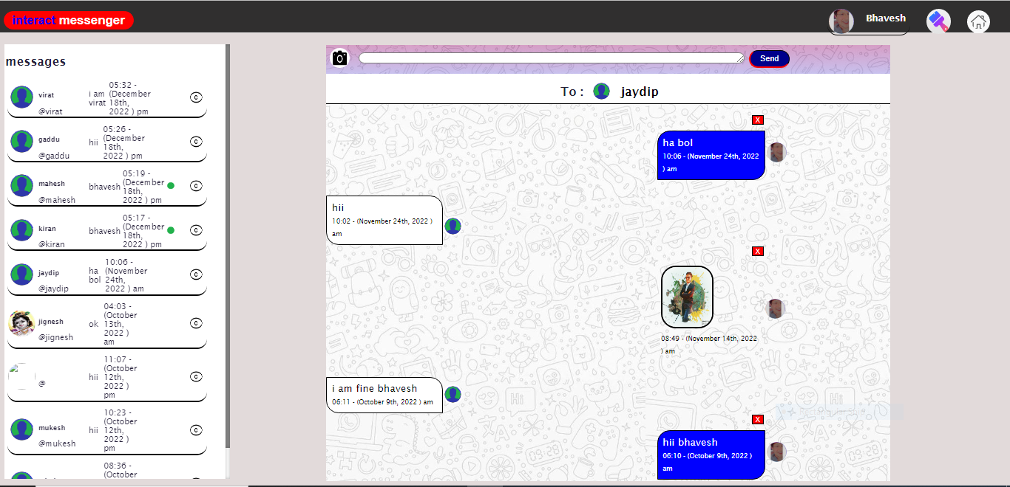

Slide 39
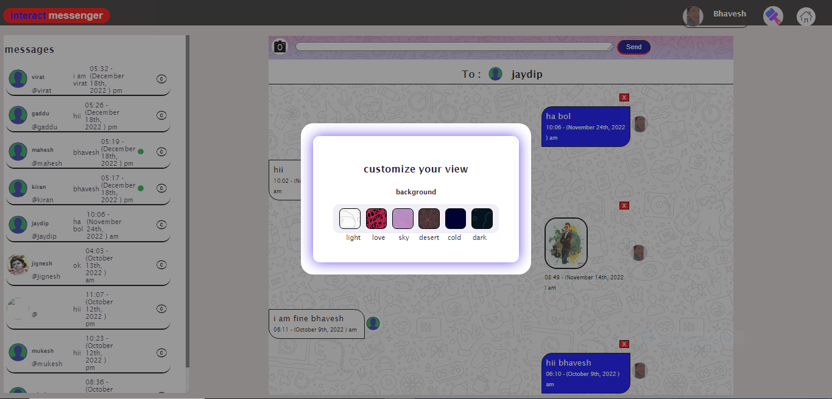

Slide 40
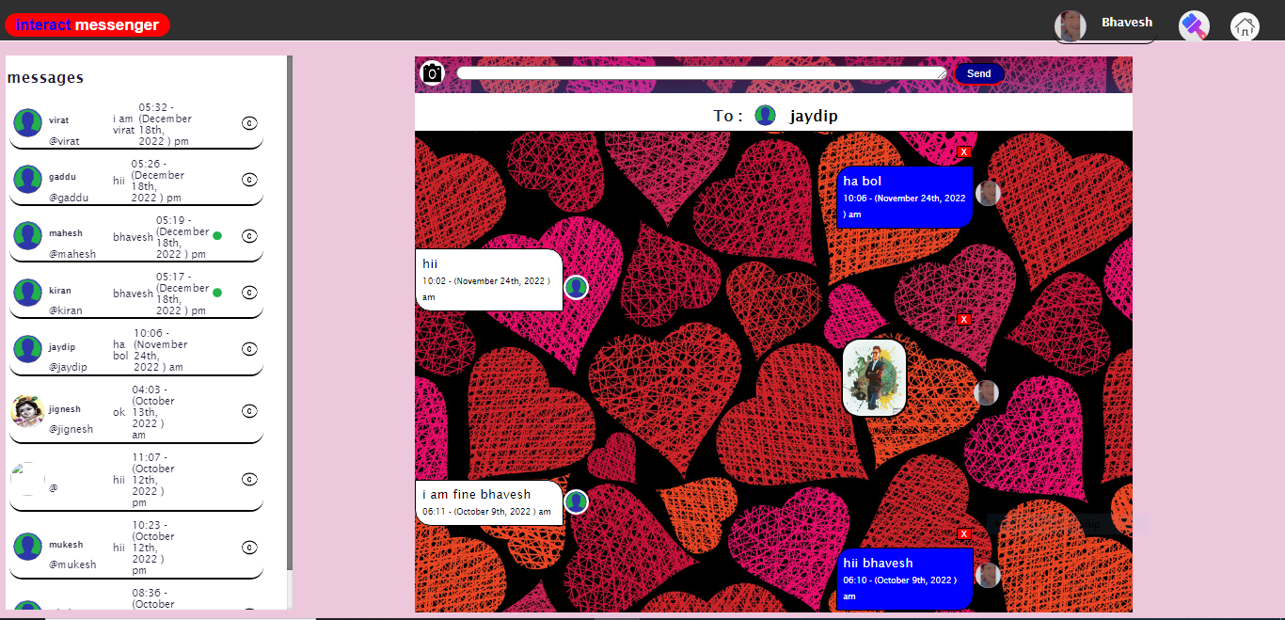
paresh
Hmm
11:02(march 25th, 2022) am

Slide 41
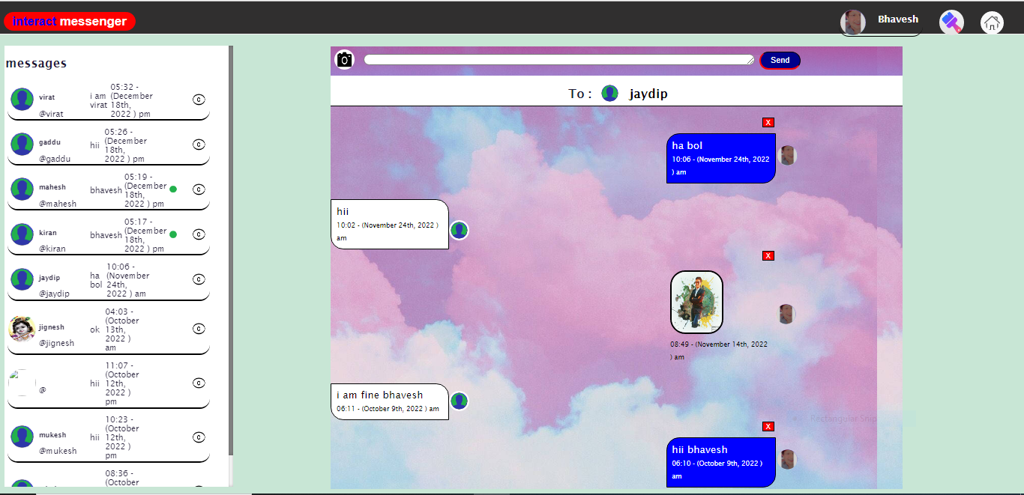
paresh
Hmm
11:02(march 25th, 2022) am

Slide 42
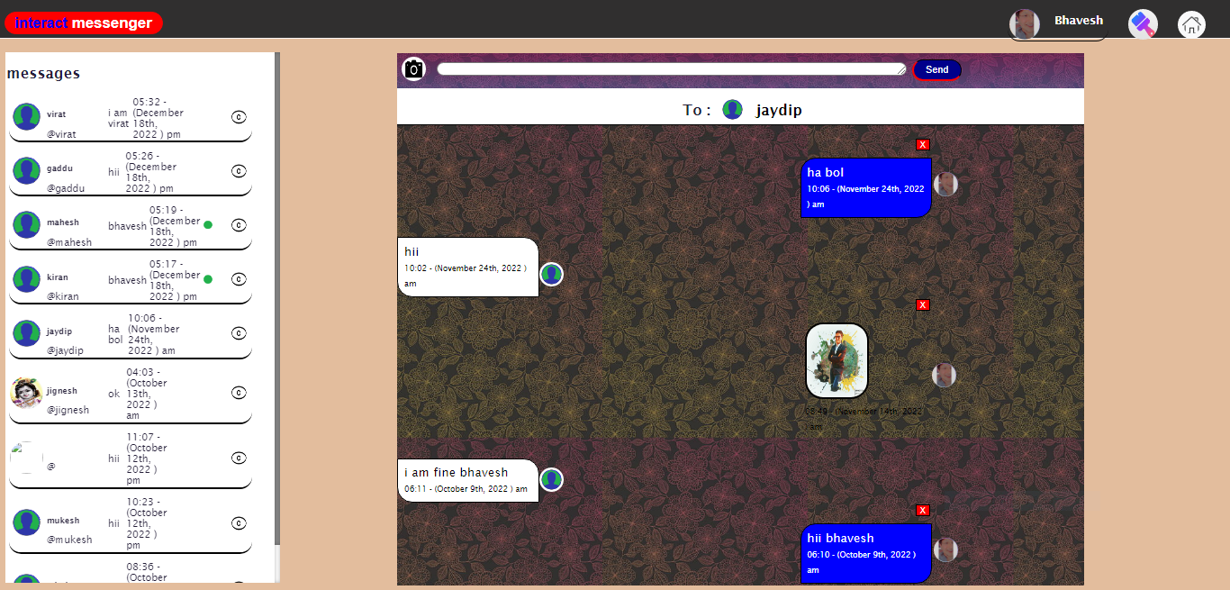
paresh
Hmm
11:02(march 25th, 2022) am

Slide 43
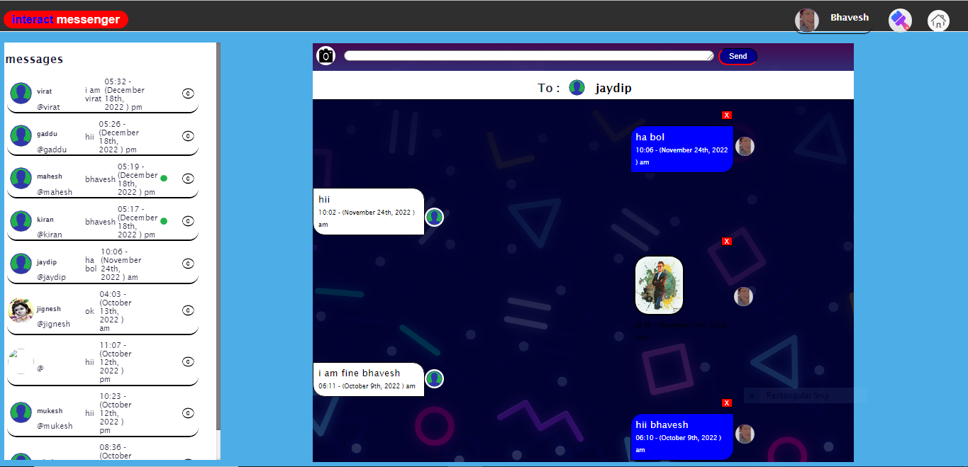
paresh
Hmm
11:02(march 25th, 2022) am

Slide 44
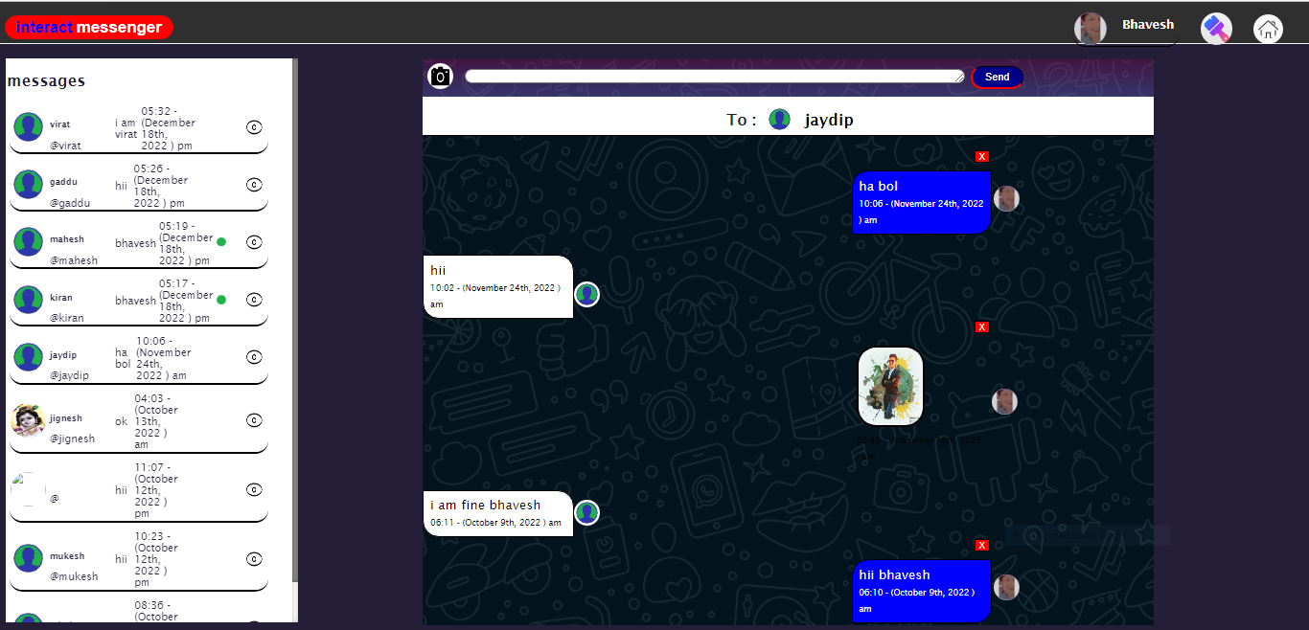
paresh
Hmm
11:02(march 25th, 2022) am

Slide 45
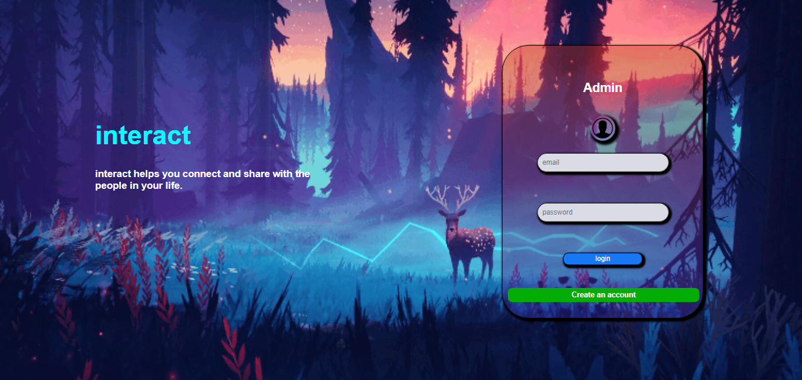

Slide 47
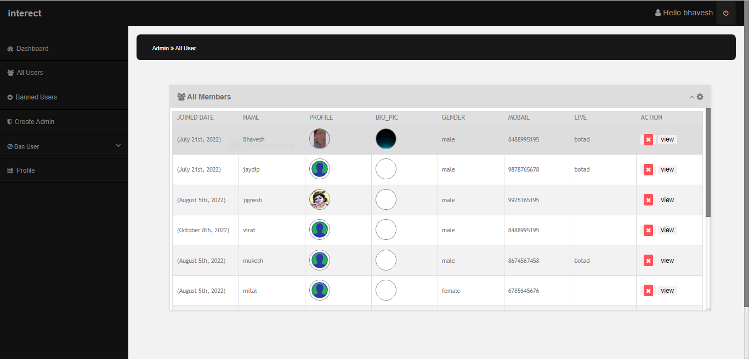

Slide 48
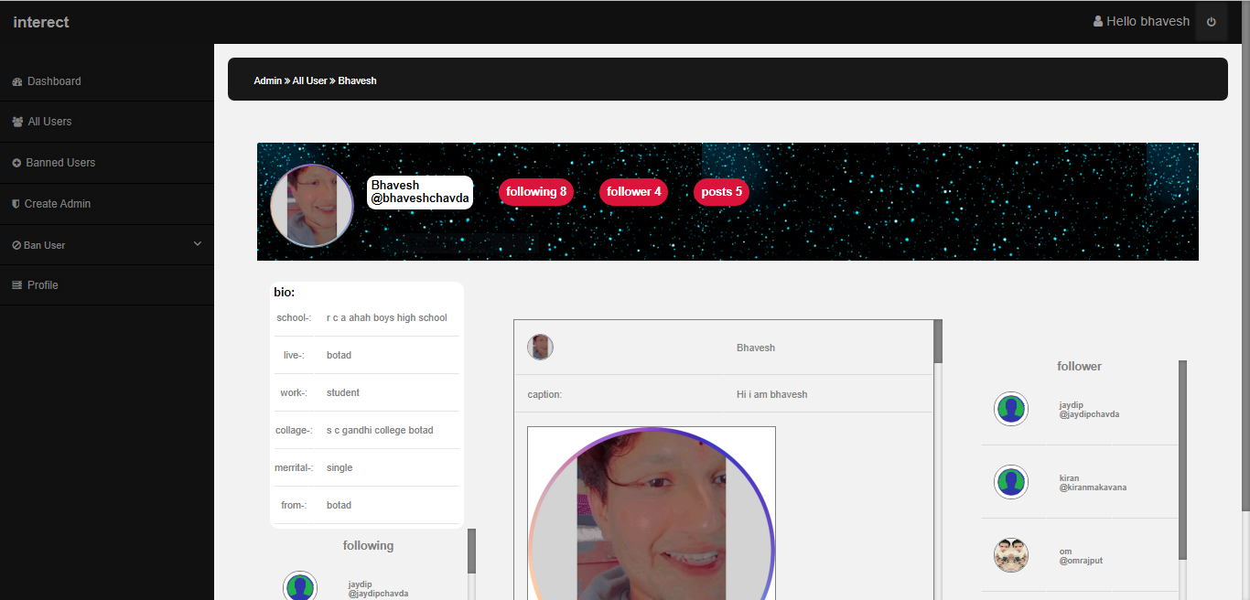

Slide 49
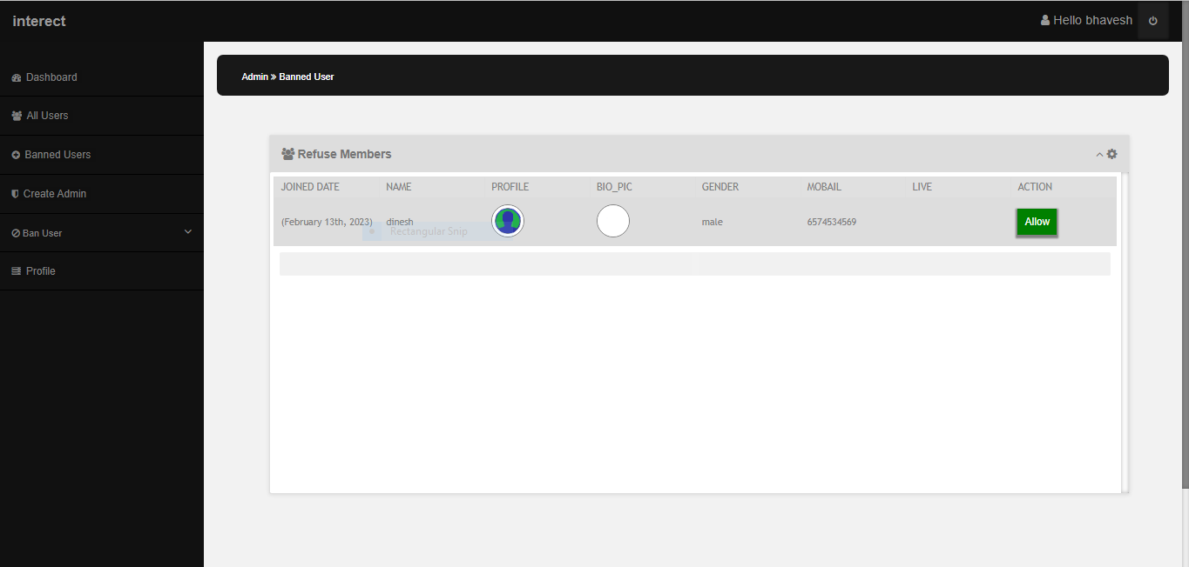

Slide 50
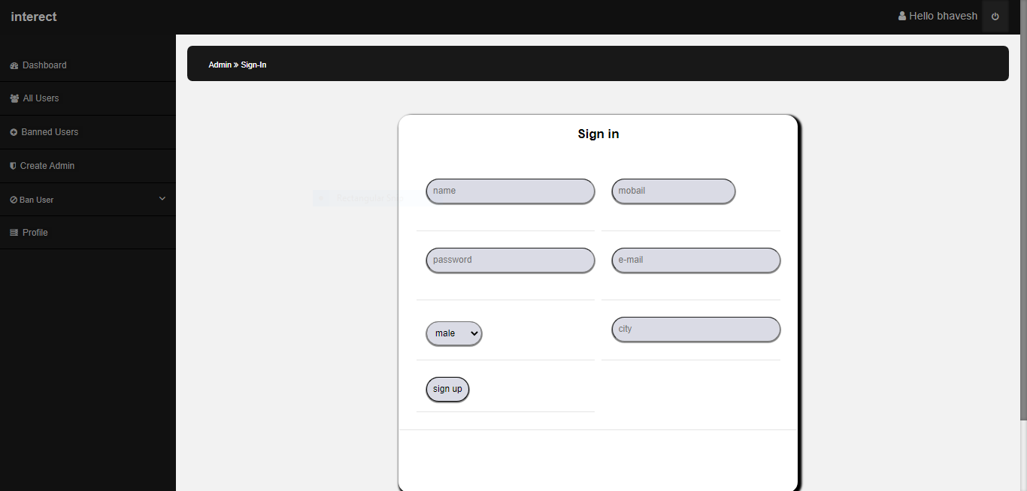

Slide 51
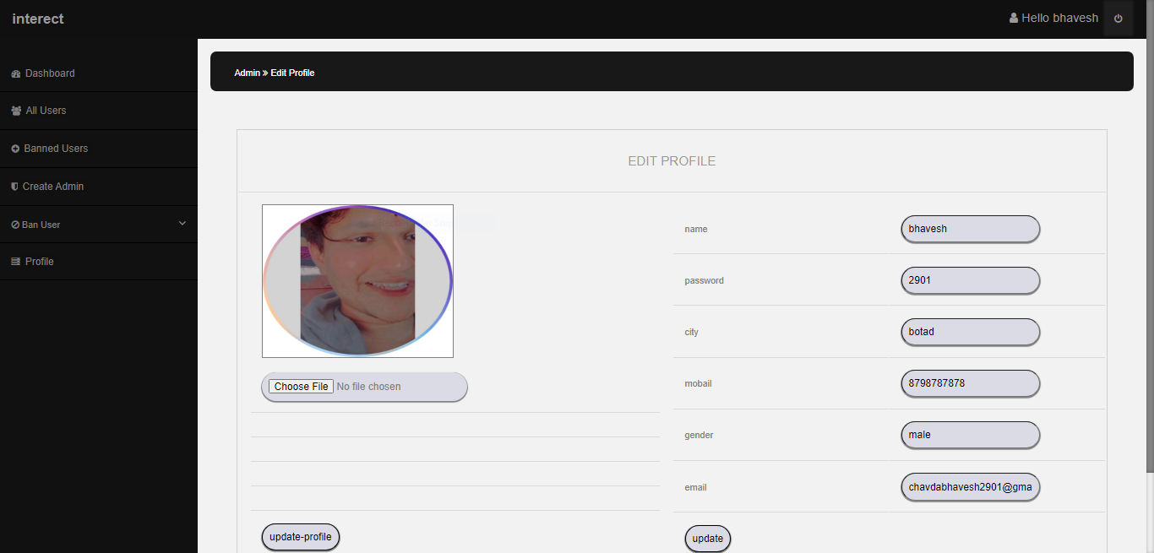


Slide 52
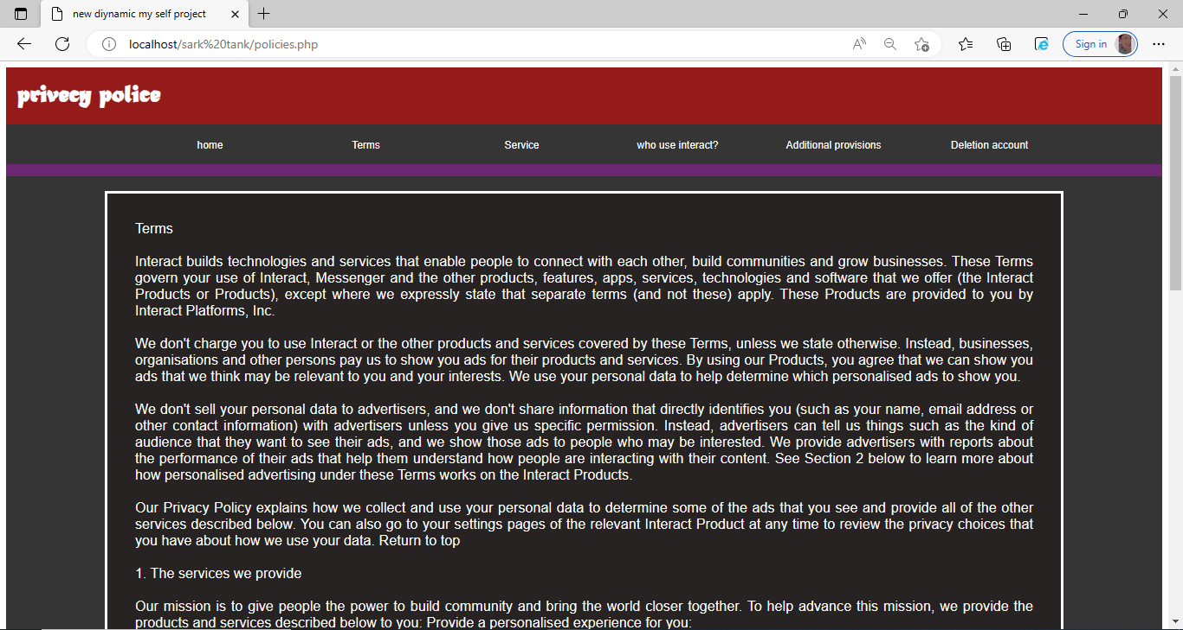

Slide 53
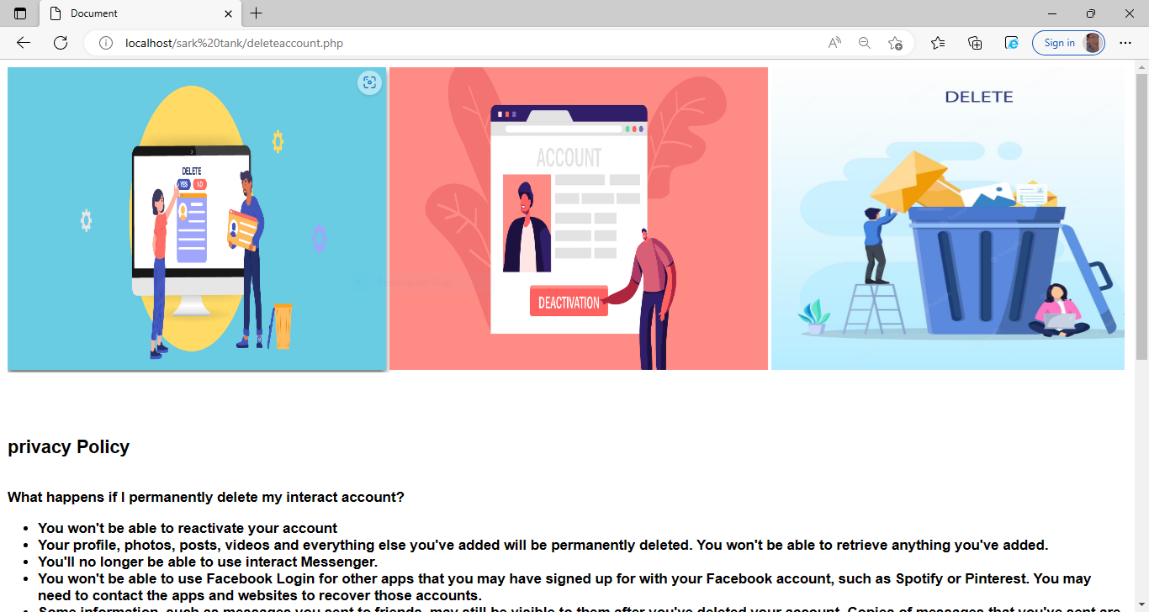
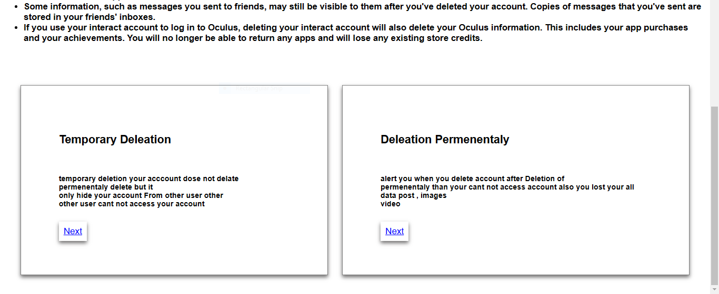

Slide 54
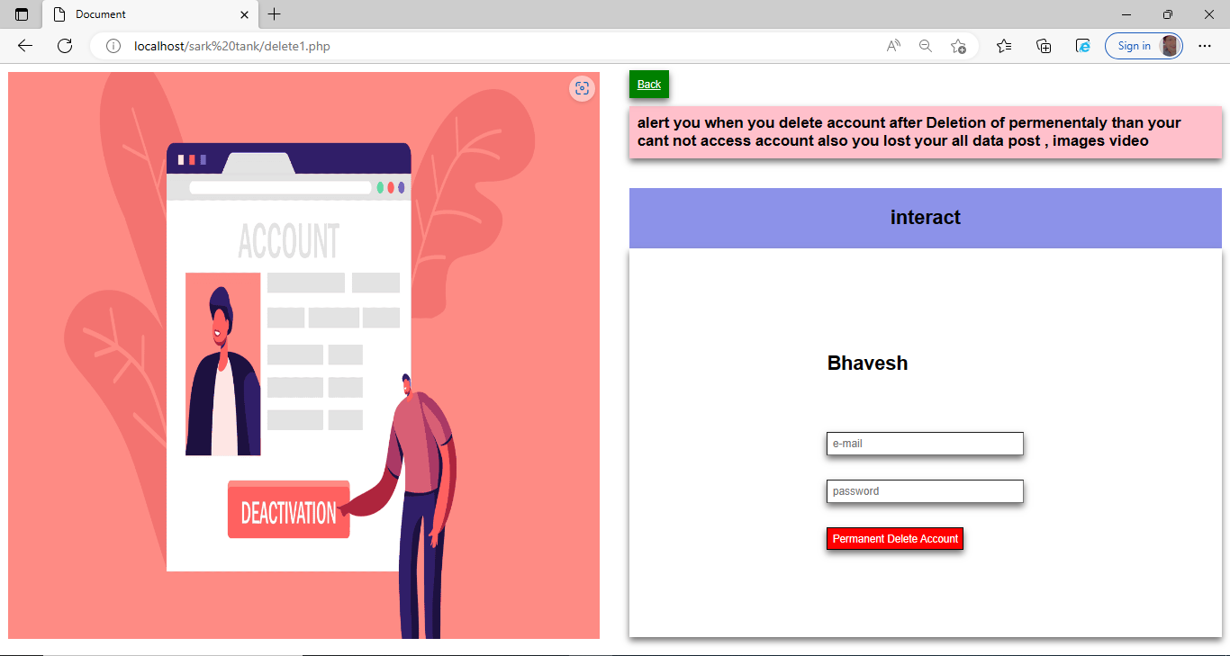

Slide 55
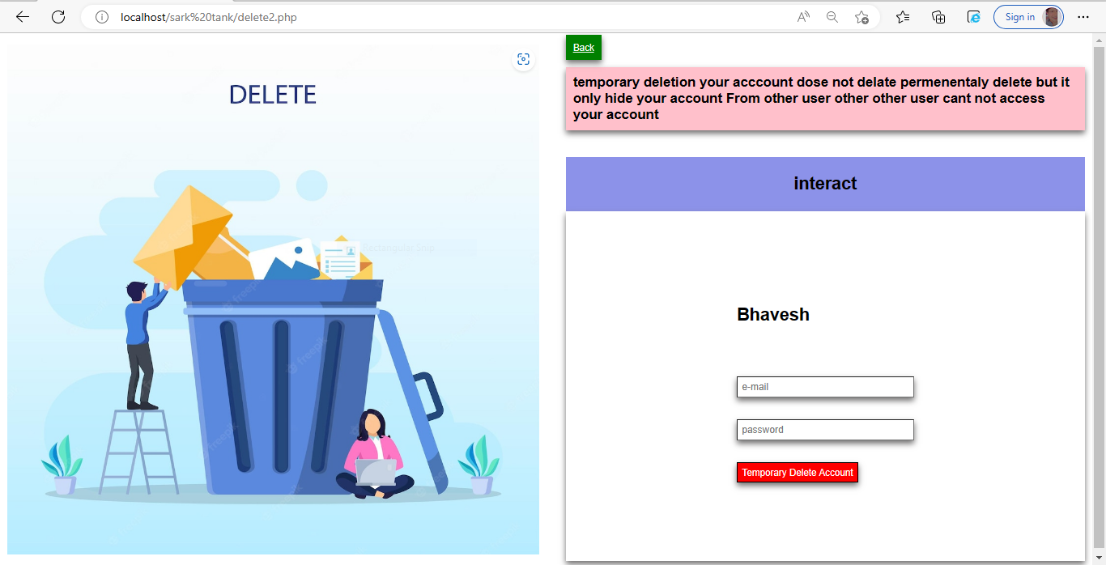

Slide 56


